Slide 1
Android Native C/C++ Debug
Charles Liu
2013/9/26
有了它，小伙伴们再也不用为调试native code而烦恼啦(*^_^*)

Slide 2
Outline
Debug JNI
Debug system so

Slide 3
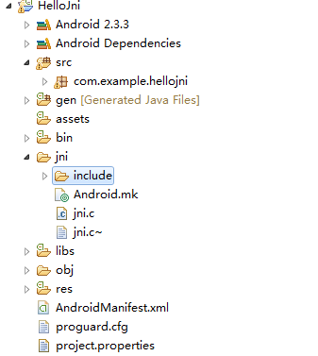
Debug JNI
1. Prepare App using JNI (my sample:HelloJni)

Slide 4
Debug JNI
2.pls notice that make the app debuggable
Config AndroidManifest.xml

Slide 5
Debug JNI
3. build debuggable jni
Using ndk to build

Slide 6
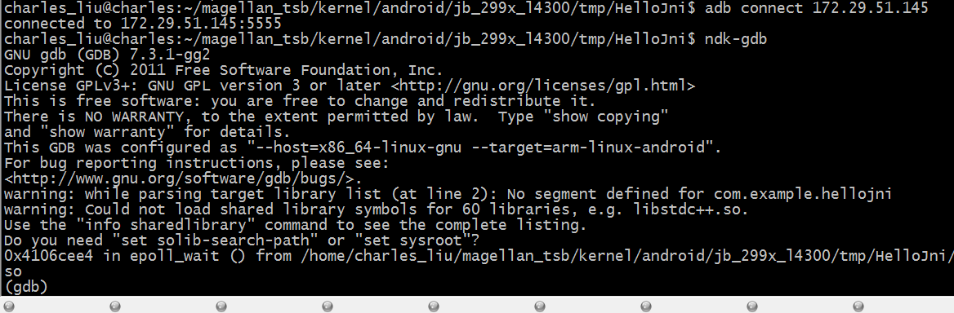
Debug JNI
4. Run app and use ndk-gdb to debug

Slide 7
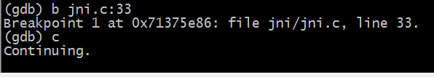
Debug JNI
5. add breakpoints and start bug

Slide 8
Debug system so
This chapter will show how to debug system so file
Example: debug mediaplayer
First prepare server (on TV device)
Then prepare client (your remote console)

Slide 9
Debug system so
1.Prepate Server
1.1 Get process id of /system/bin/mediaserver by ps cmd
Assume the id is 582
1.2 Start gdbserver and attach the process
gdbserver 172.29.51.145:1234 --attach 582
(172.29.51.145 is the tv’s ip)

Slide 10
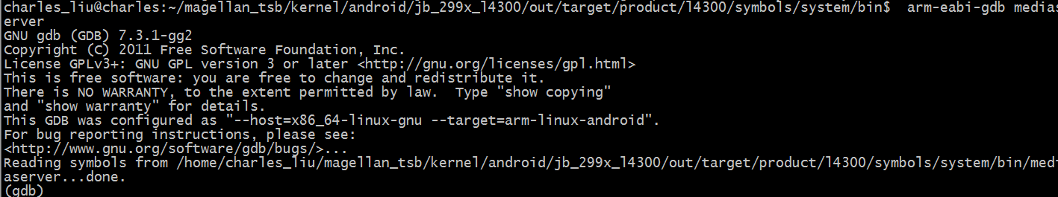
Debug system so
2 prepare client
2.1.go to system/bin
2.2 start gdb with cmd: arm-eabi-gdb mediaserver

Slide 11
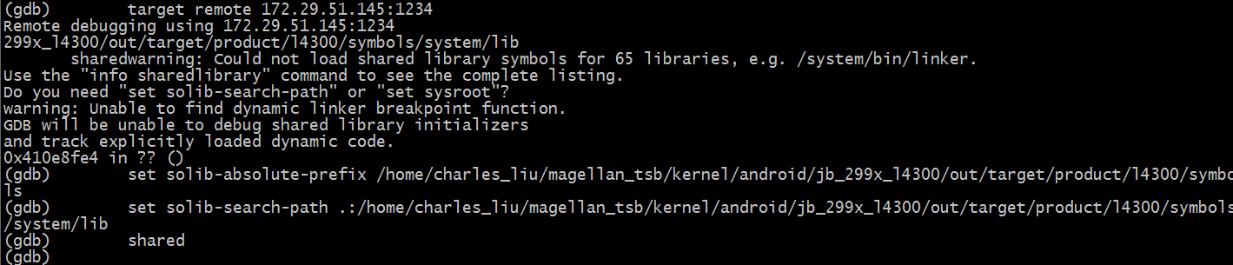
Debug system so
3 start debug
3.1 connect server and set enviroment
3.2 add breakpoints and start debug
Notes:
target remote 172.21.55.66:1234
set solib-absolute-prefix /home/charles_liu/magellan_tsb/kernel/android/jb_299x_l4300/out/target/product/l4300/symbols
set solib-search-path .:/home/charles_liu/magellan_tsb/kernel/android/jb_299x_l4300/out/target/product/l4300/symbols/system/lib
shared
c

Slide 12
Thanks

